Slide 1
20. Belief (Bayesian) Networks
CSCI 561 Foundation for Artificial Intelligence
Professor Wei-Min Shen
University of Southern California

Slide 2
Belief (Bayesian) Networks
Motivation
Independence and Conditional Independence
Syntax and Semantics
Reasoning with Belief Networks
Construction of Belief Networks
Inference Algorithms
Exact inference
Approximate inference

Slide 3
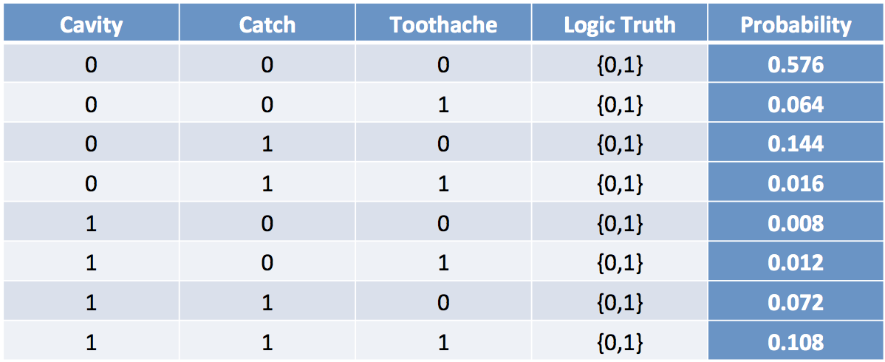
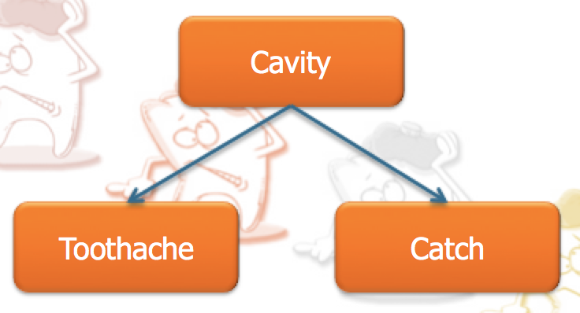
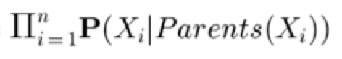
Why Bayesian Networks?
A better representation for the Probability Distribution Model
(take advantage of “variable independence”)
Fully Joint Distribution Table
Bayesian Network
⇔
P(X₁, X₂, …, X_{n})
Size = O(d^{n})
d: variable domain
⇔
Size = O(nd^{k})
k: # of parents

Slide 4
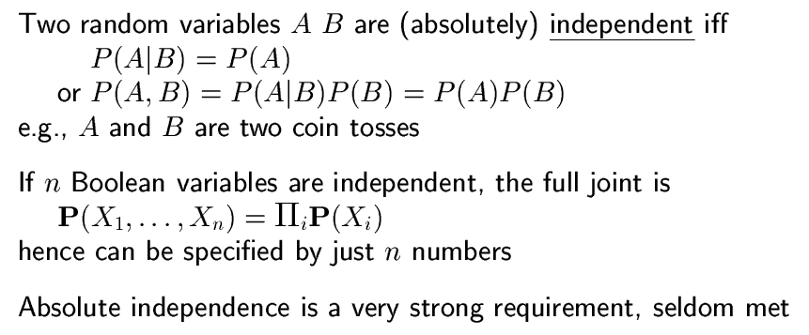
Independence

Slide 5
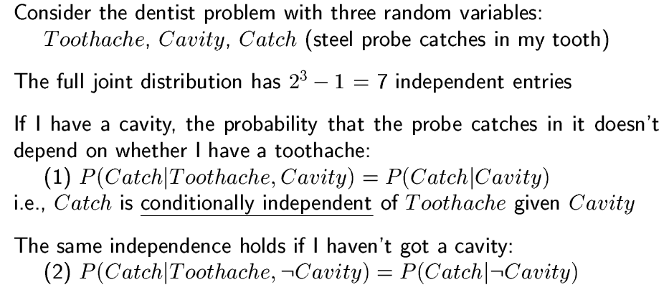
Conditional Independence

Slide 6

Conditional Independence
Cavity
Toothache
Catch
Other interactions may exist, but they are either insignificant, unknown or irrelevant. We leave them out.

Slide 7




Conditional Independence
Cavity
Toothache
Catch
We assume that a “catch” is not influenced by a “toothache” and visa versa.

Slide 8
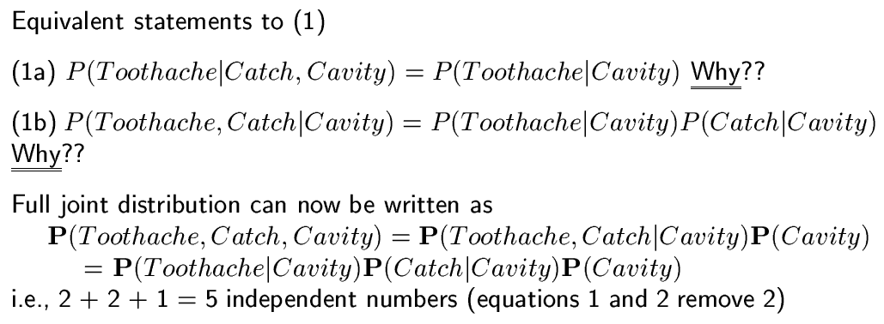
Conditional Independence

Slide 9
Conditional Independence
Cavity
Catch
Cavity
=
Toothache
Toothache
(1a) Since Catch does not affect Toothache
P(Toothache | Catch, Cavity) = P(Toothache | Cavity)

Slide 10
Conditional Independence
Cavity
Cavity
Cavity
=
Toothache
Catch
Toothache
Catch
(1b) Algebraically, these statements are equivalent
P( Toothache, Catch | Cavity) = P(Toothache | Cavity) P(Catch |Cavity)

Slide 11
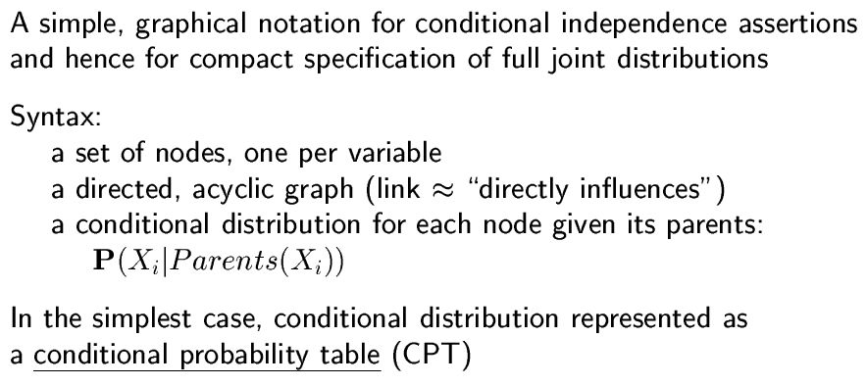
Belief Networks

Slide 12
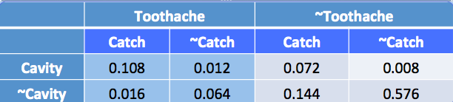
Bayesian Network vs. Full Joint Distribution
BN has less entries than FJD, but contains the same information!
Cavity
0.2
The Full Joint Distribution needs 8 numbers
The BN needs
only 5 numbers
Cavity
Cavity | Toothache
T | 0.6
F | 0.1
Cavity | Catch
T | 0.9
F | 0.2
Conditional
Probability Table
(CPT)
Toothache
Catch

Slide 13
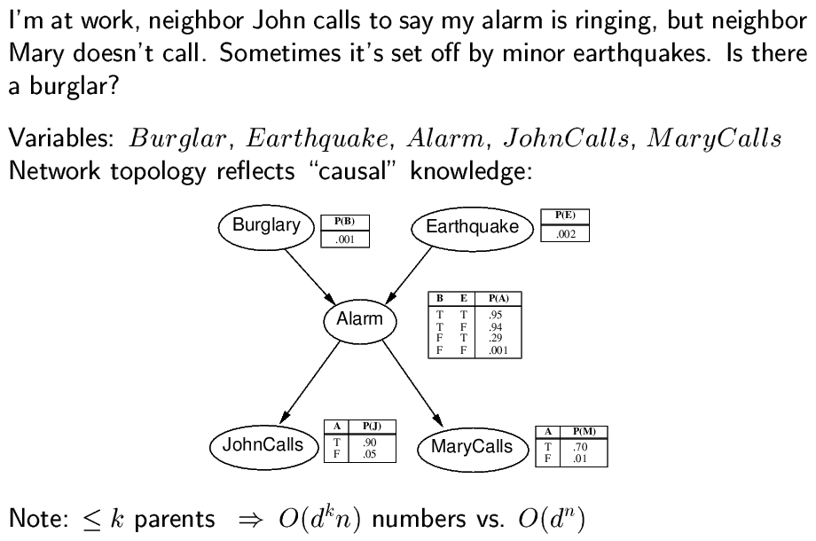
Example
The Full Joint Distribution needs 2^5 = 32 values
The BN needs
only 10 values
Conditional Probability Table
(CPT)
k=2
d=2
n=5
full joint distribution

Slide 14
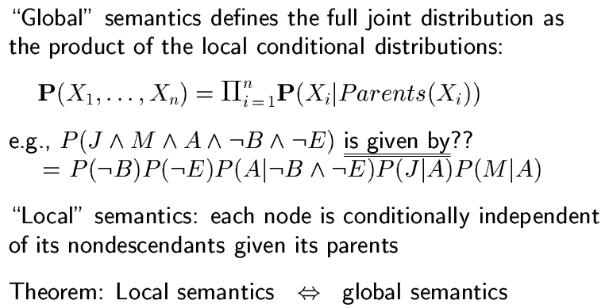
Semantics

Slide 15
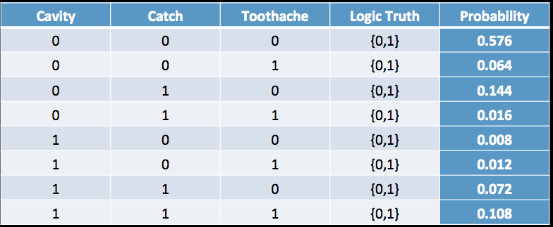
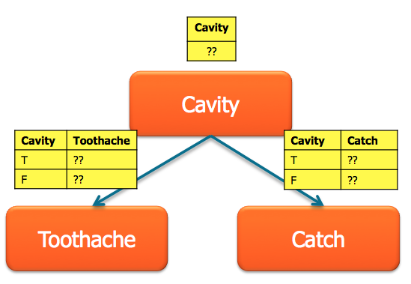
Bayesian Network ⬄ Full Joint Distribution
?
Try it yourself!

Slide 16
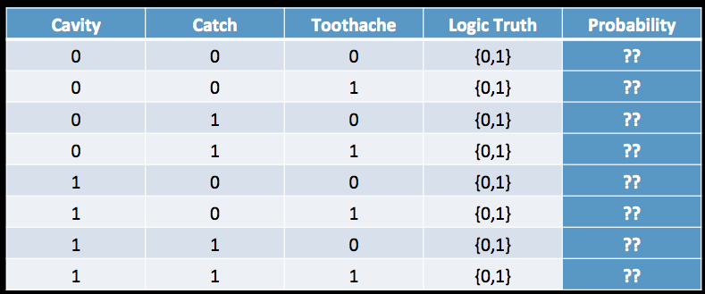
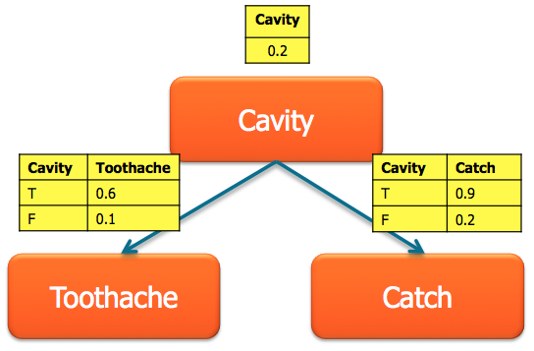
Bayesian Network ⬄ Full Joint Distribution
?
Try it yourself!

Slide 17
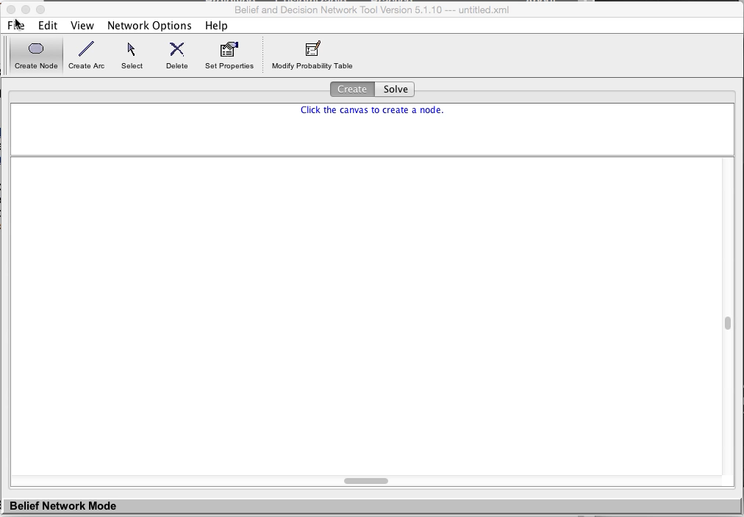
Demo

Slide 18
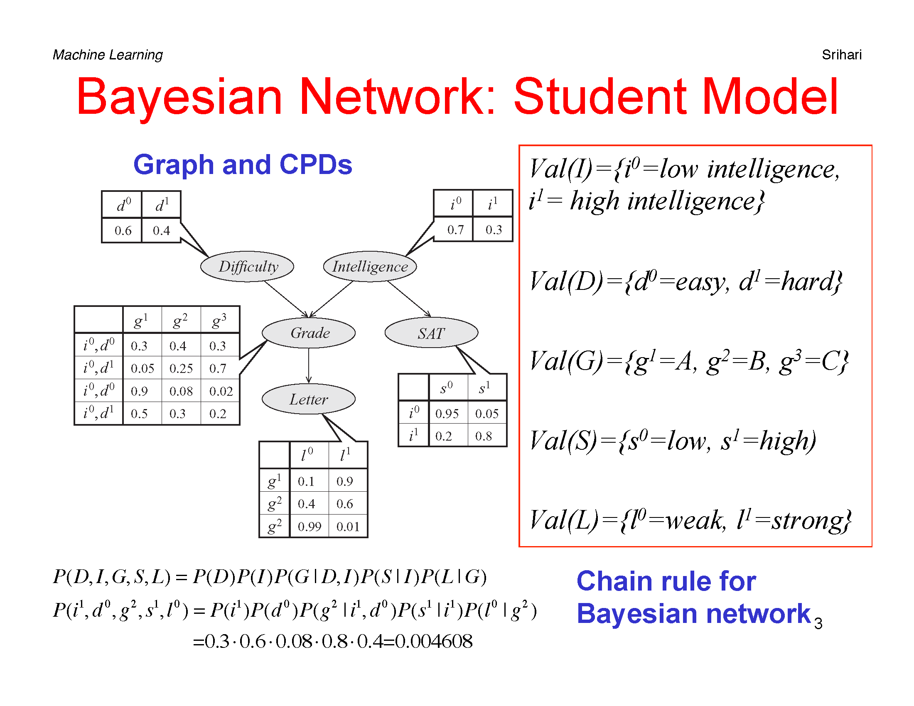
http://www.cs.utah.edu/~hal/courses/2010S_AI
typo: these two
rows are for i¹
{

Slide 19
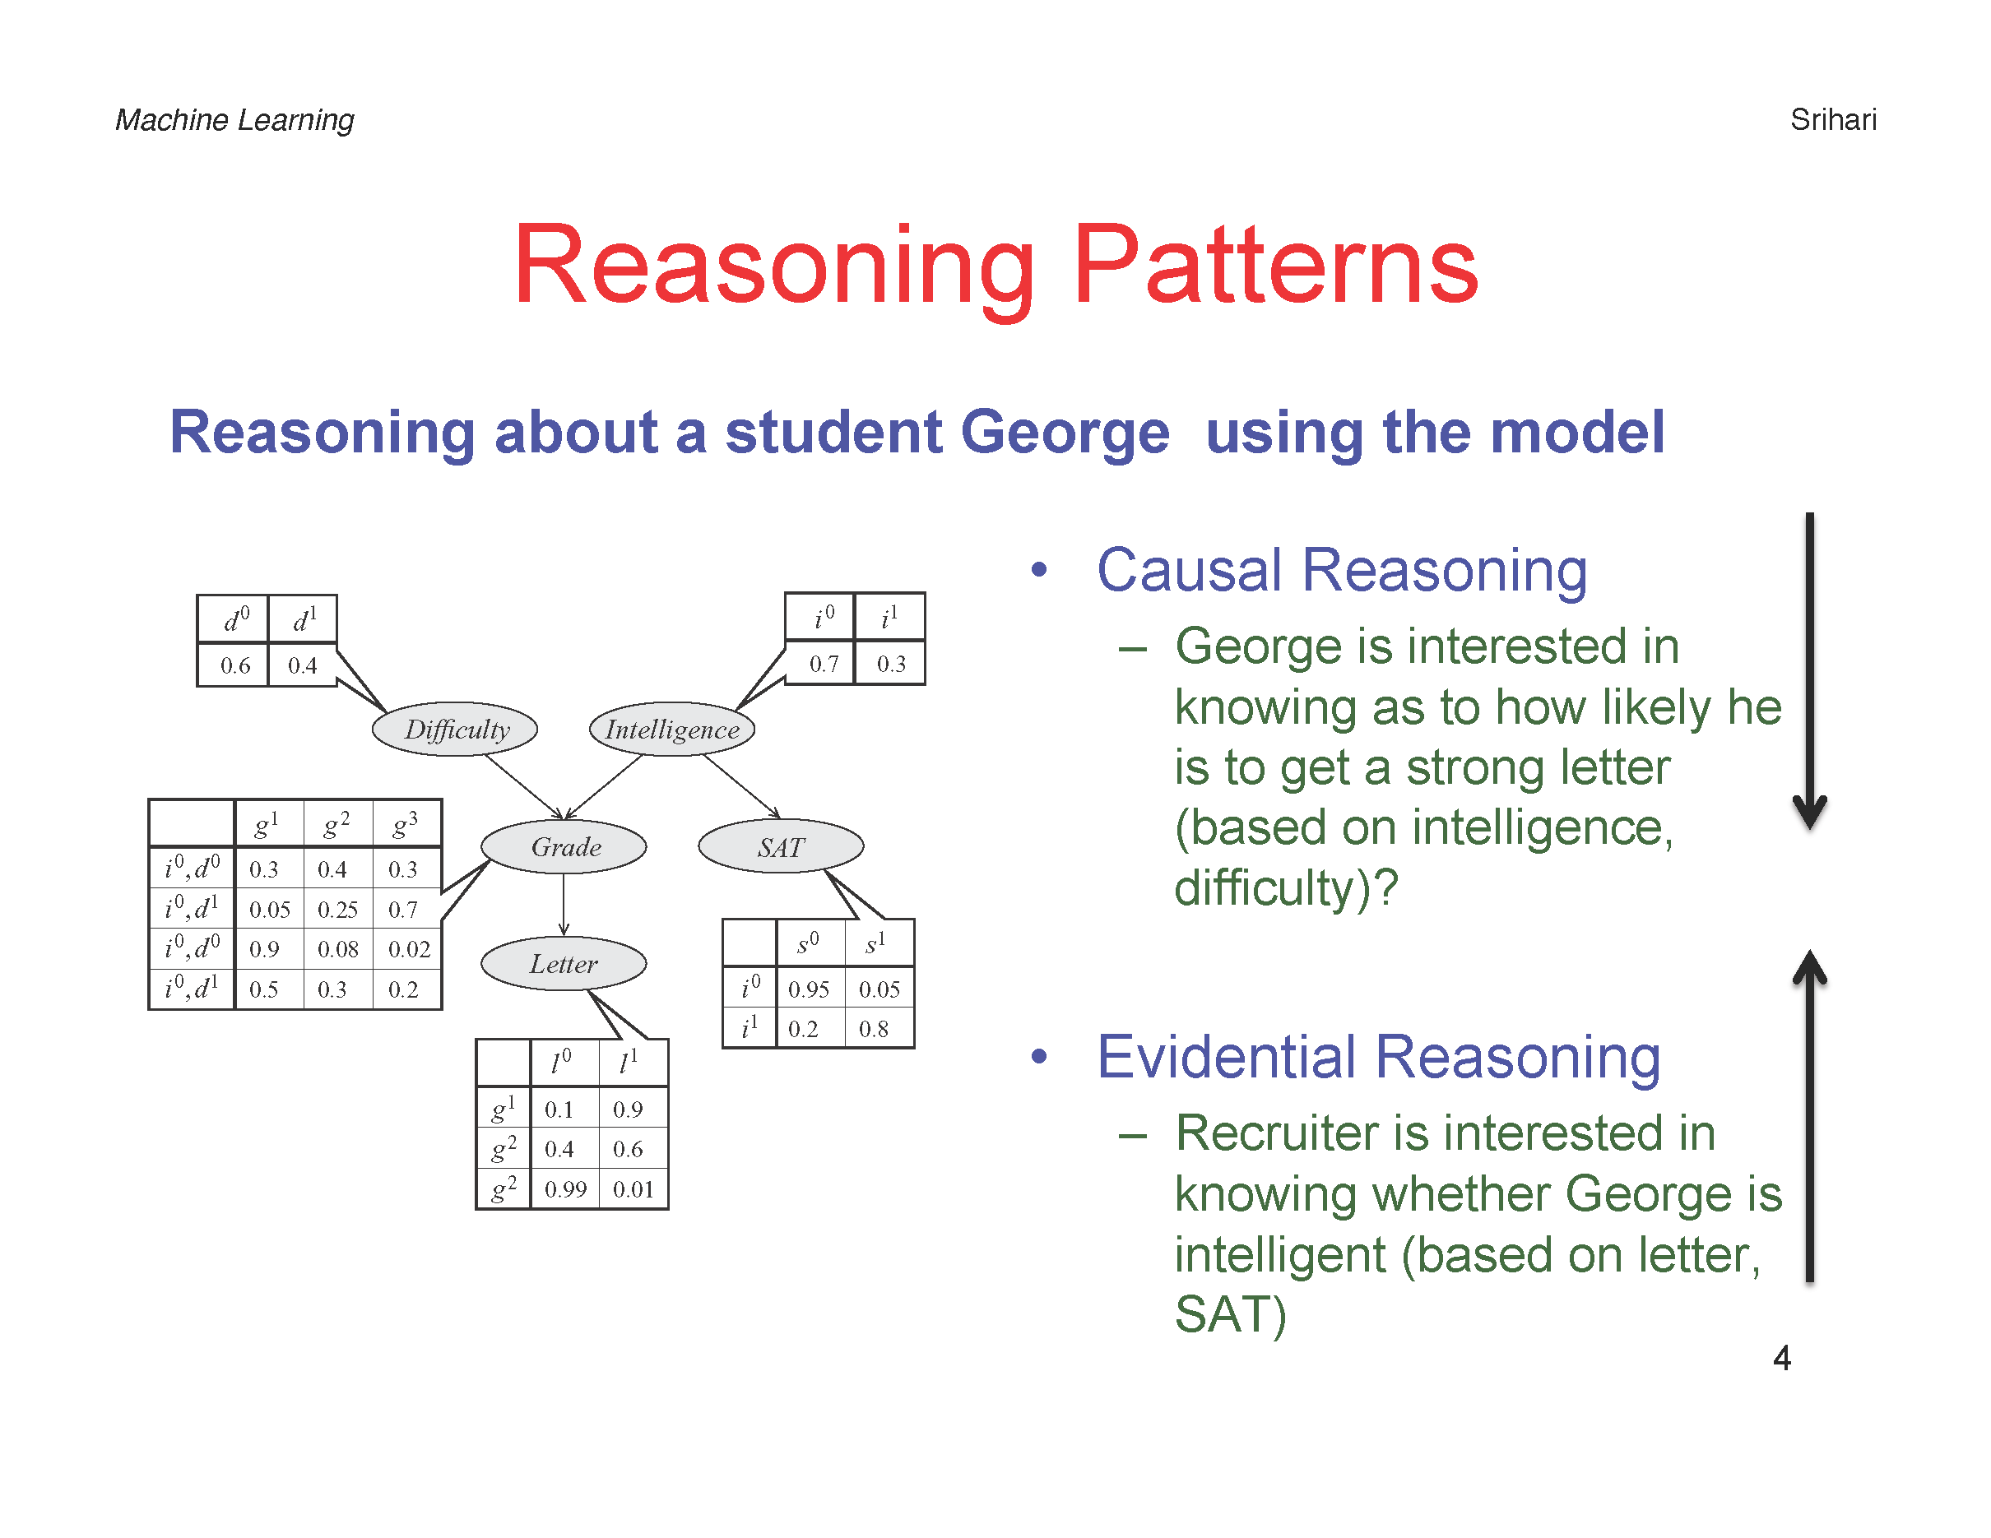

Slide 20
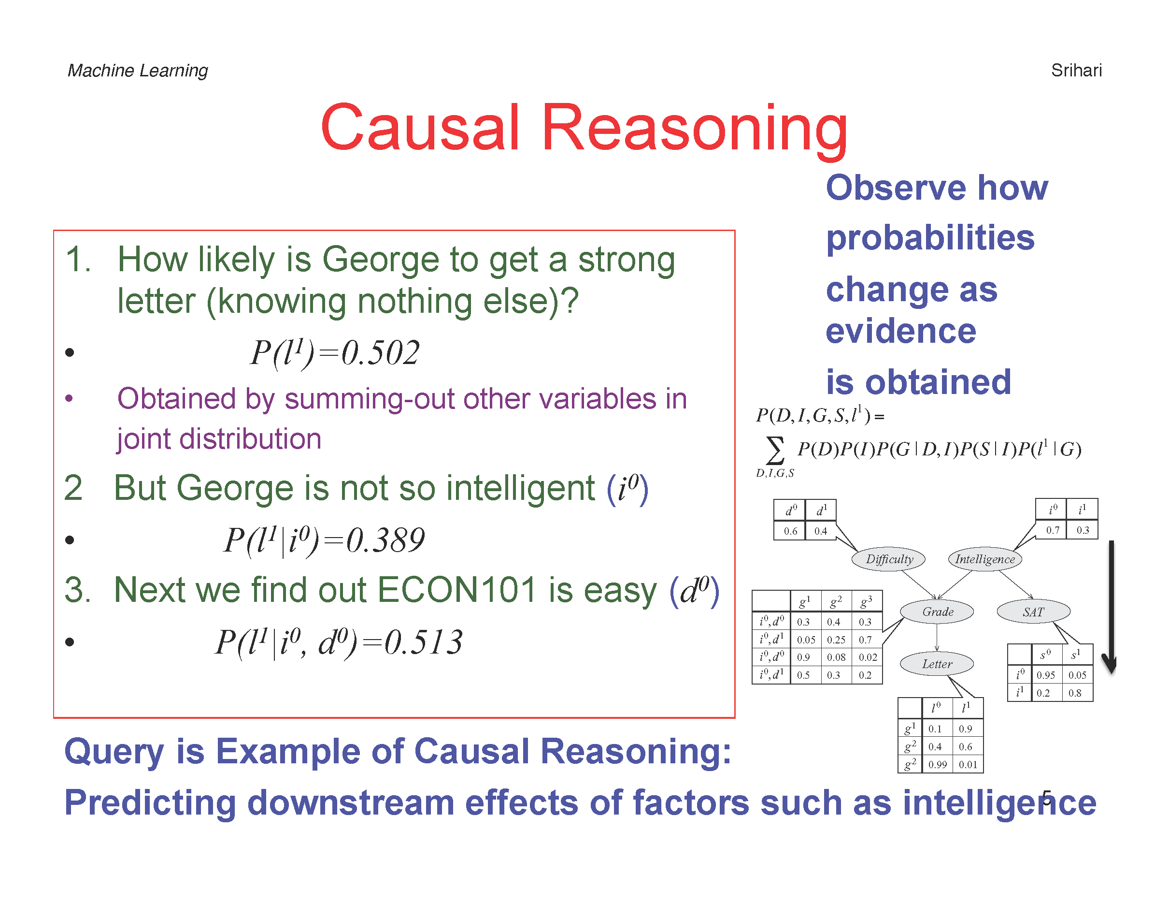
Try it yourself:
=P(l¹i⁰)/P(i⁰)
=P(l¹i⁰d⁰)/P(i⁰d⁰)

Slide 21
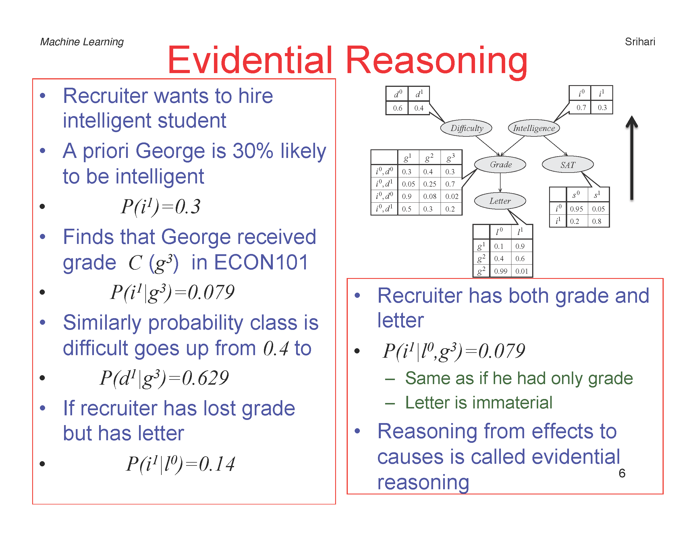

Slide 22
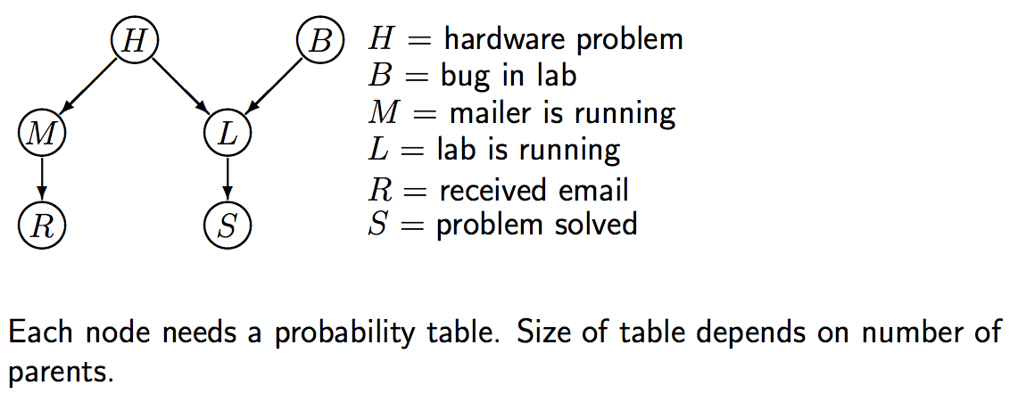
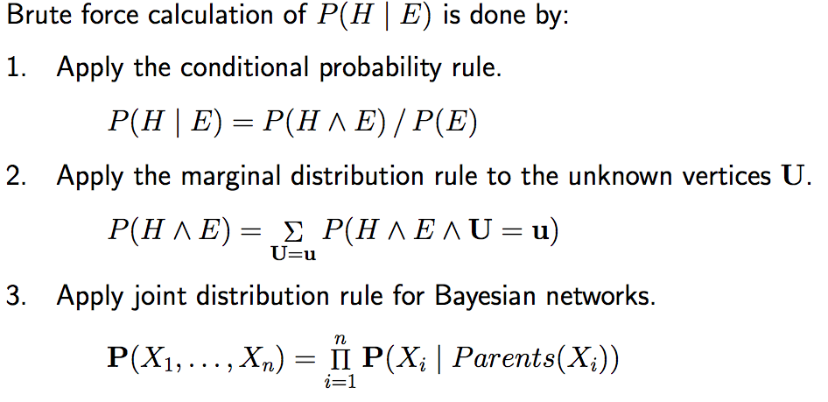
Evidential Reasoning Example
http://www.cs.utsa.edu/~bylander/cs5233/

Slide 23
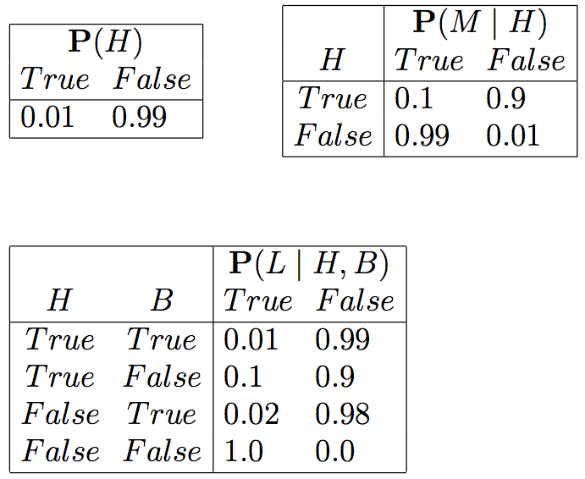
Example
http://www.cs.utsa.edu/~bylander/cs5233/
e.g.,

Slide 24
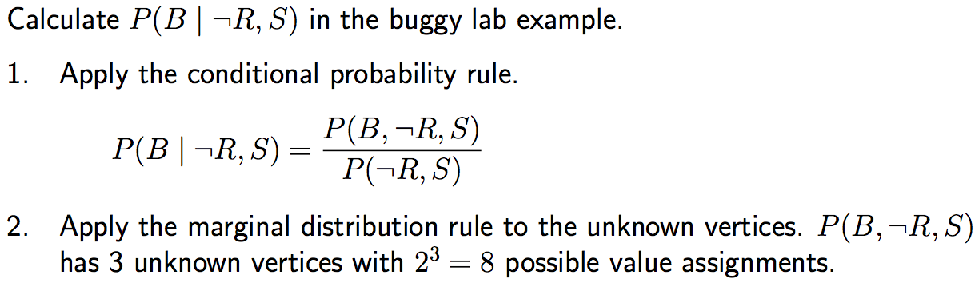
Evidential Reasoning Example
http://www.cs.utsa.edu/~bylander/cs5233/

Slide 25
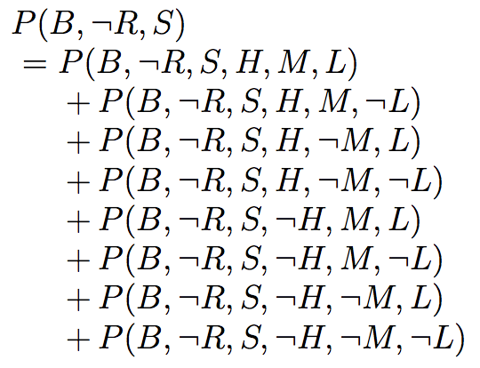
Evidential Reasoning Example
http://www.cs.utsa.edu/~bylander/cs5233/

Slide 26
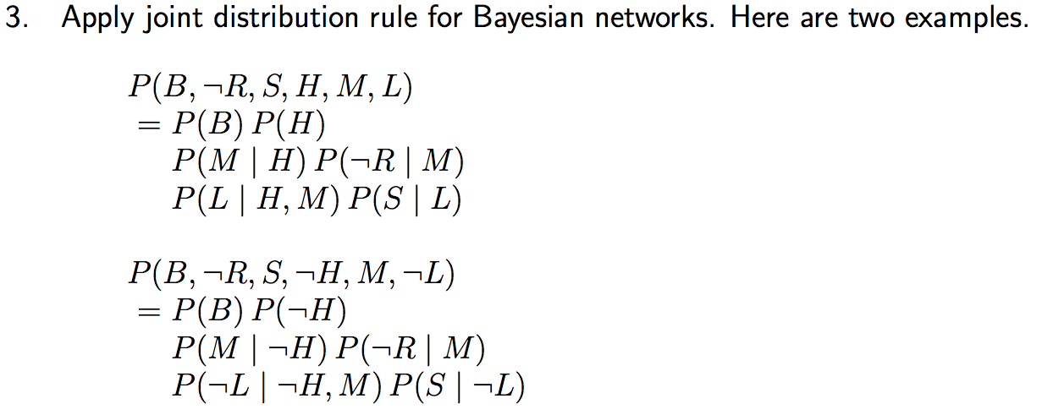

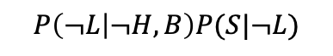
Evidential Reasoning Example
http://www.cs.utsa.edu/~bylander/cs5233/

Slide 27
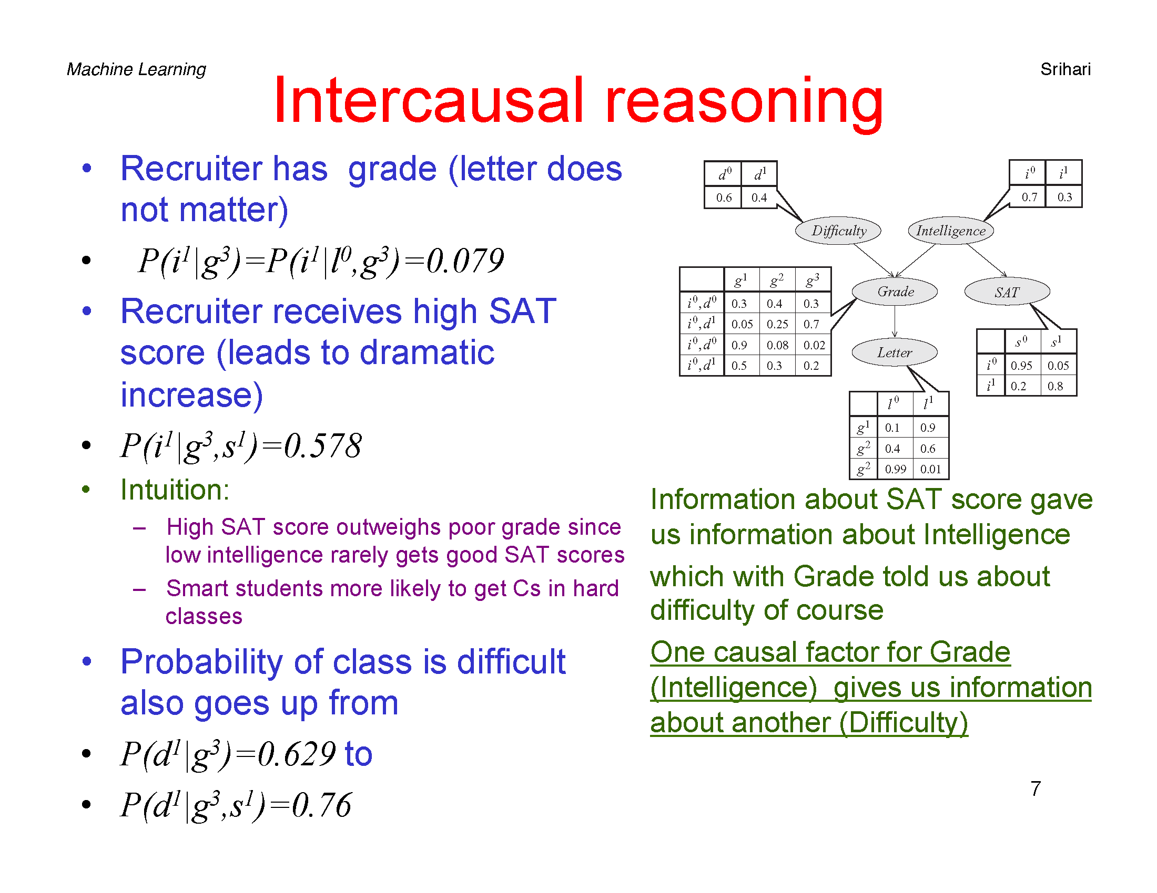

Slide 28
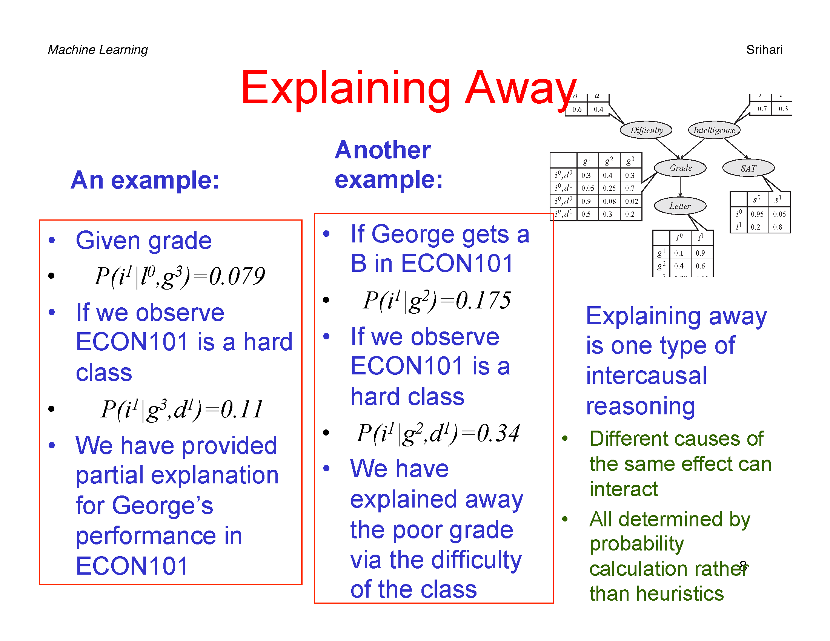

Slide 29
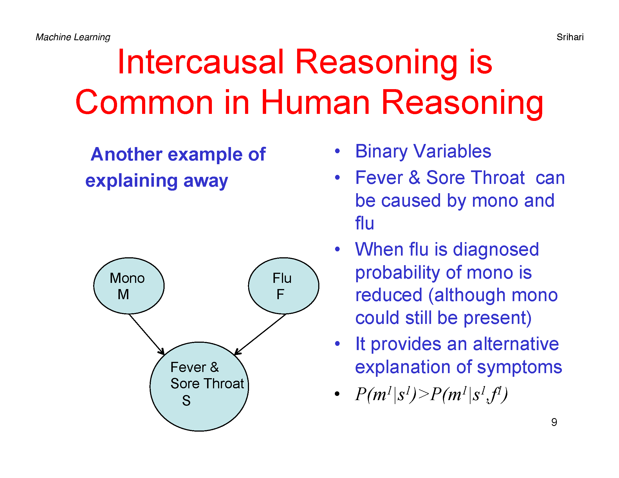

Slide 30
Constructing Belief Networks

Slide 31
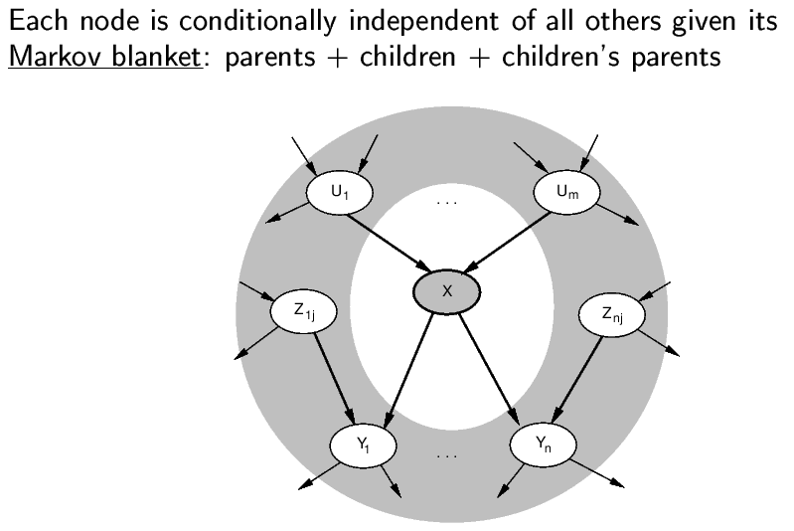
The Markov Blanket

Slide 32
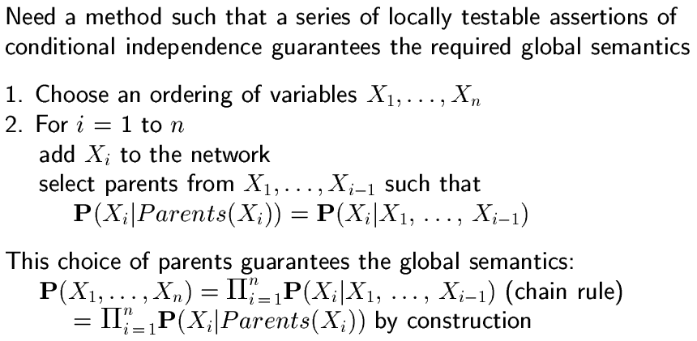
Constructing Belief Networks

Slide 33
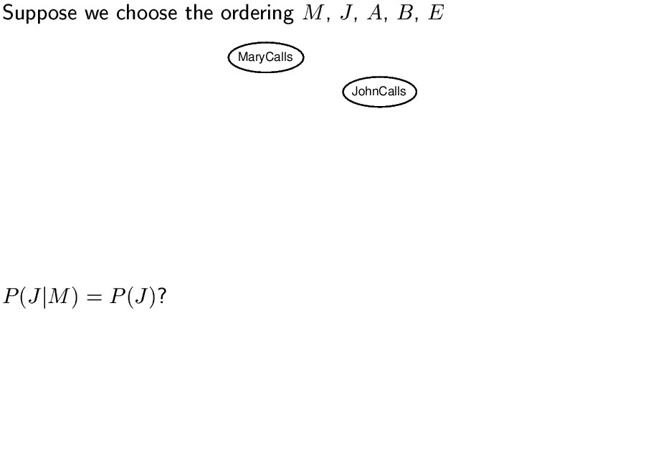
Example

Slide 34
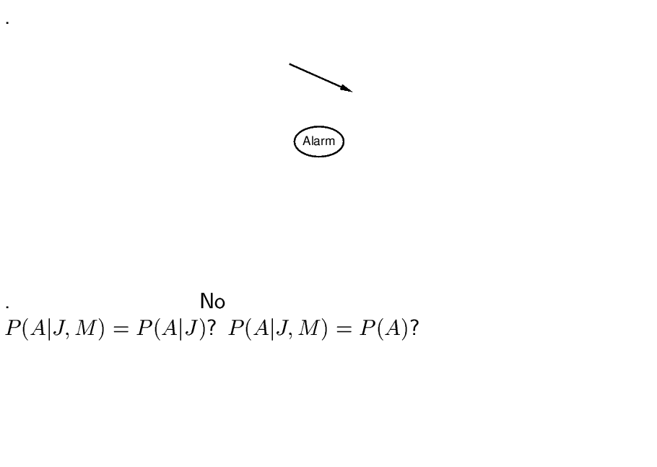

Slide 35
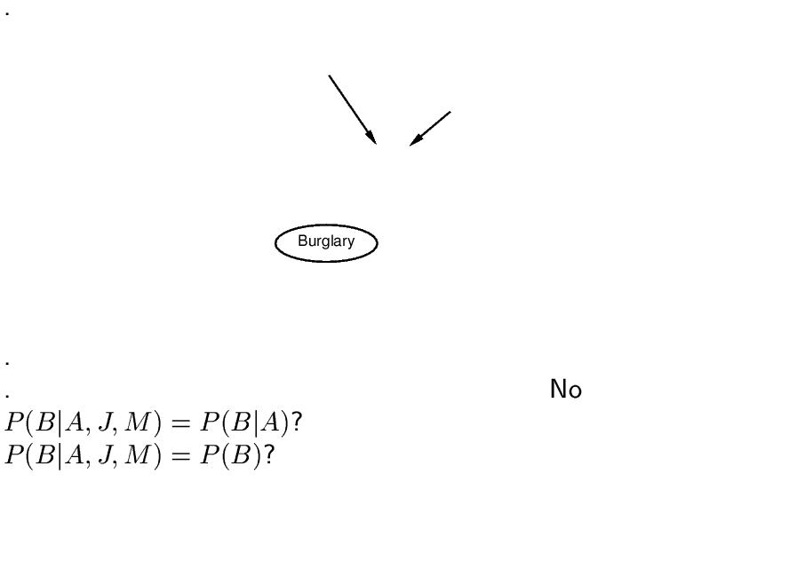

Slide 36
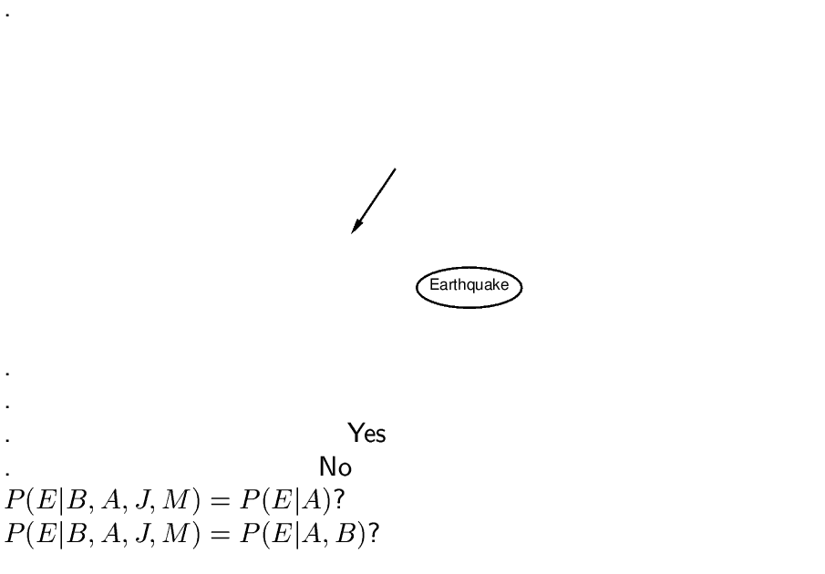

Slide 37
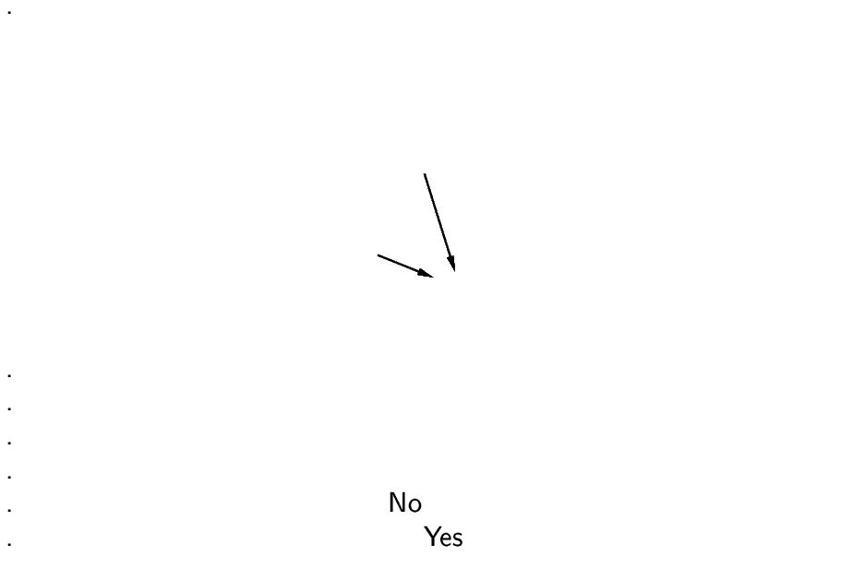

Slide 38
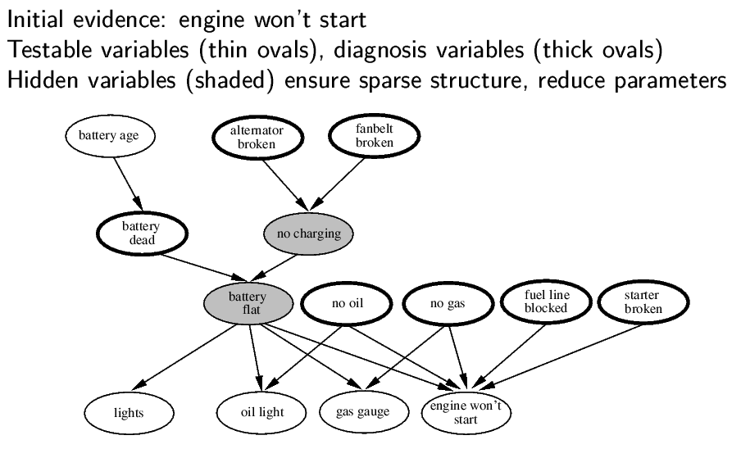
Application: Car Diagnosis

Slide 39
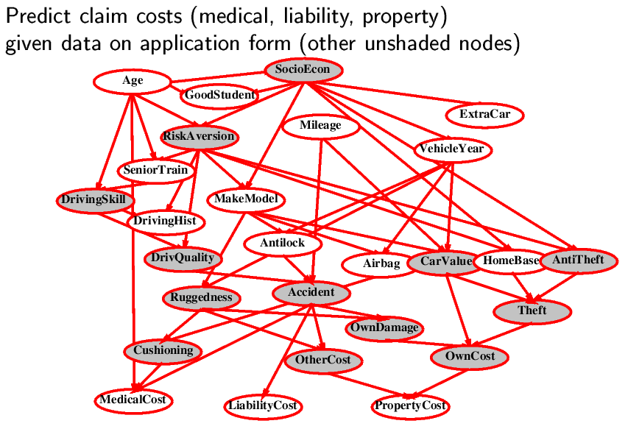
Application: Car Insurance

Slide 40
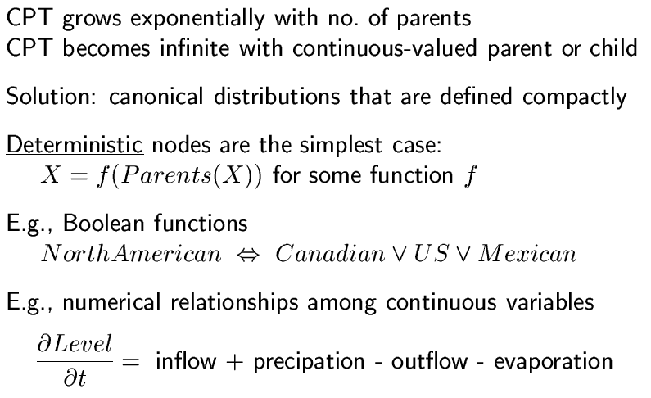
Conditional Distributions (for Compactness)

Slide 41
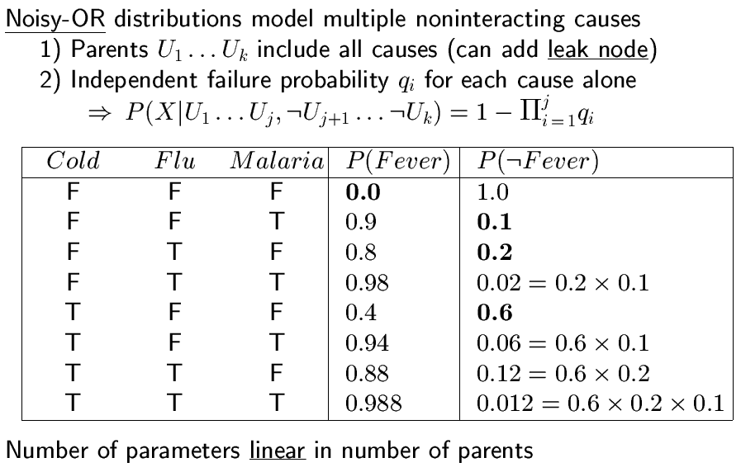
Compact conditional distributions

Slide 42
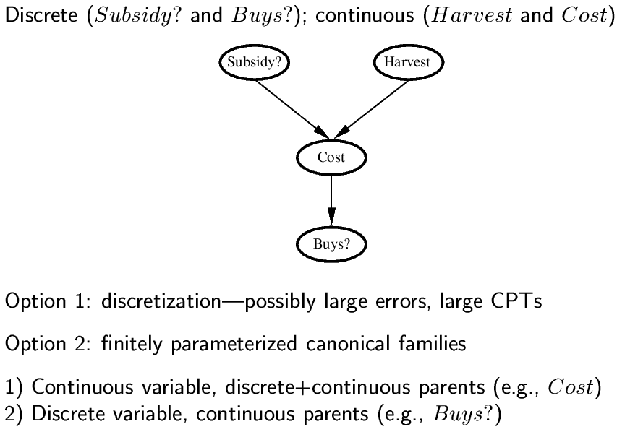
Hybrid (Discrete + Continuous) Networks

Slide 43
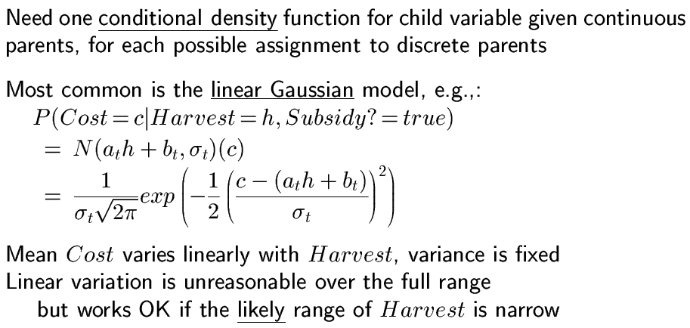
Continuous child variables

Slide 44
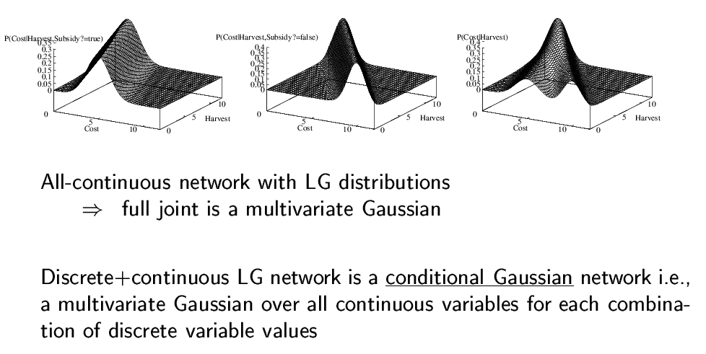
Continuous child variables

Slide 45
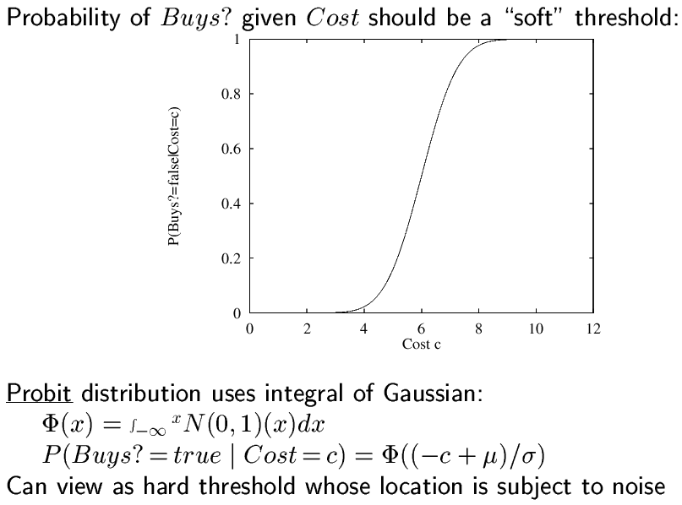
Discrete Variable & Continuous Parents

Slide 46
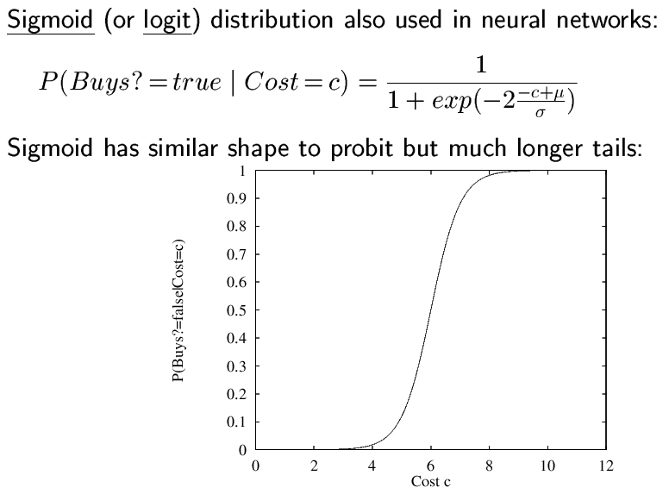
Discrete Variable & Continuous Parents

Slide 47
Belief (Bayesian) Networks
Motivation
Conditional Independence
Syntax and Semantics
Reasoning with Belief Networks
Construction of Belief Networks
Inference Algorithms
Exact Inferences
By Enumeration
By Variable Eliminations
Approximate inference

Slide 48
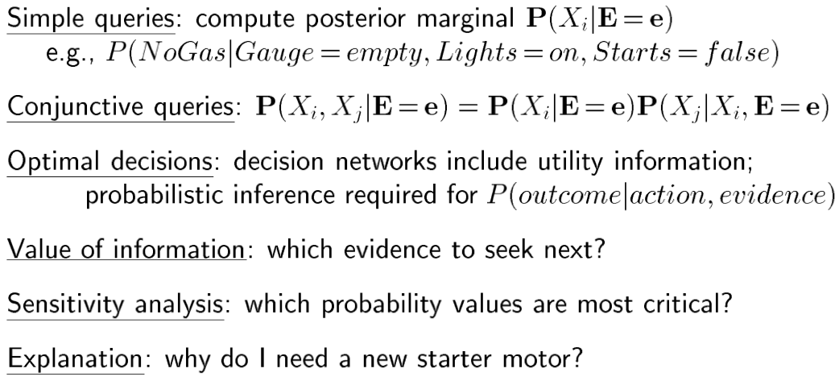
Inference Tasks

Slide 49
Enumeration Algorithm
The Key Ideas Are:

Slide 50
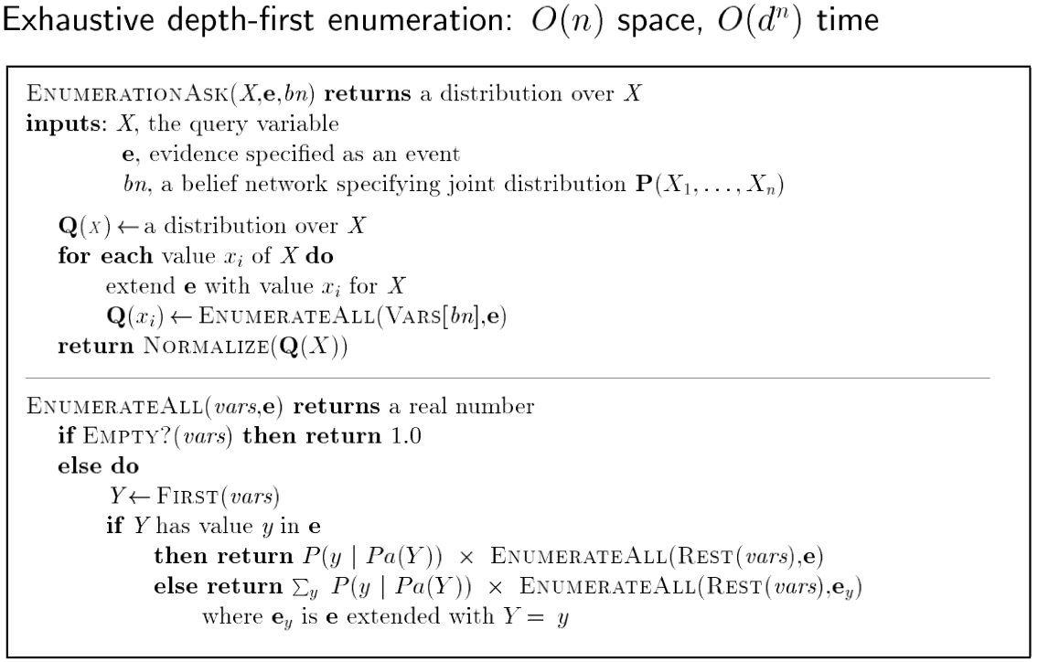
Enumeration Algorithm

Slide 51
Enumeration Example (1)
Query: P(B|~R,S)

Slide 52
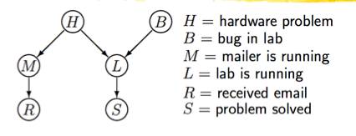
Enumeration Example (1)
= α P(B,~R,S)
P(~R,S)
=P(B,~R,S,H,M,L)
+P(B,~R,S,H,M,~L)
+P(B,~R,S,H,~M,L)
+P(B,~R,S,H,~M,~L)
+P(B,~R,S,~H,M,L)
+P(B,~R,S,~H,~M,L)
+P(B,~R,S,~H,~M,~L)
+P(~B,~R,S,H,M,L)
+P(~B,~R,S,H,M,~L)
+P(~B,~R,S,H,~M,L)
+P(~B,~R,S,H,~M,~L)
+P(~B,~R,S,~H,M,L)
+P(~B,~R,S,~H,~M,L)
+P(~B,~R,S,~H,~M,~L)

Slide 53
Enumeration Example (1)
B
B

Slide 54
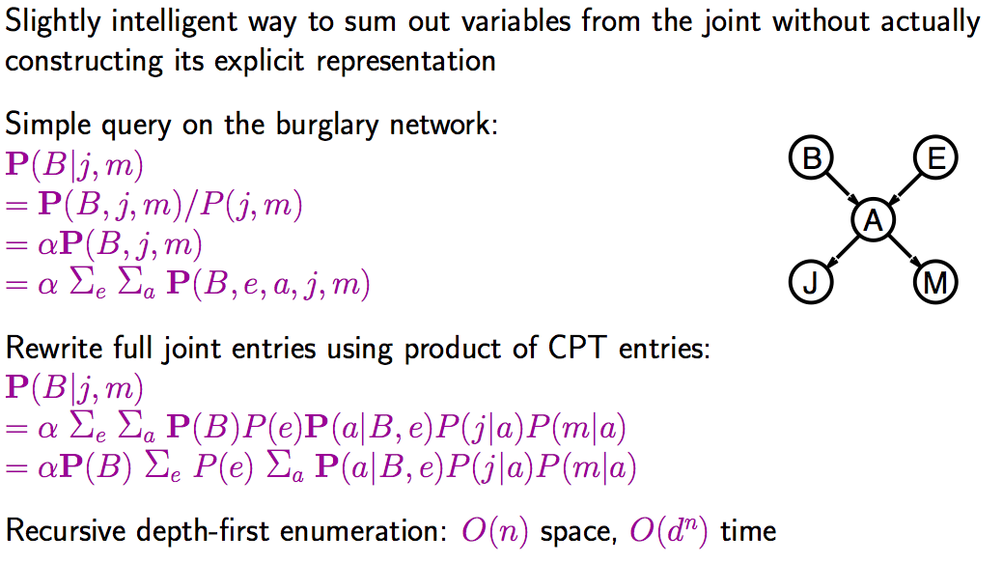
Enumeration Example (2)

Slide 55
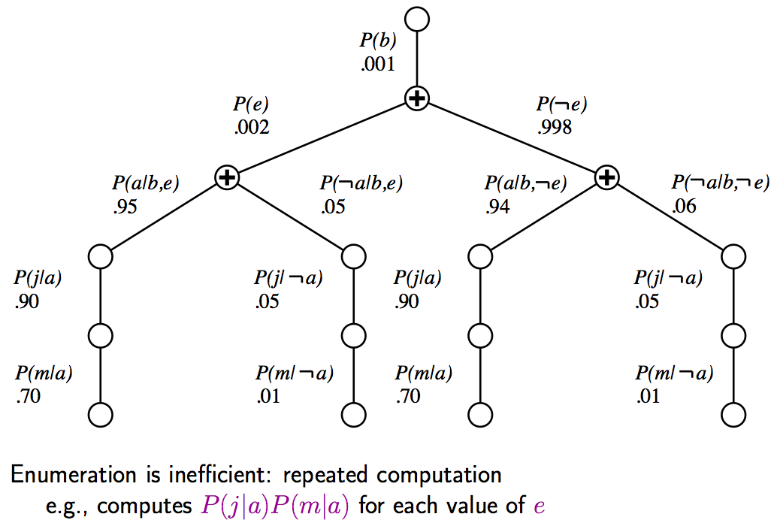
Enumeration Example (2)

Slide 56
Enumeration Example (2)

Slide 57

Variable Elimination Algorithm

Slide 58

Variable Elimination: Two Basic Operations

Slide 59


Slide 60


Slide 61

Variable Elimination Algorithm

Slide 62

Complexity of Exact Inference

Slide 63
Belief (Bayesian) Networks
Motivation
Conditional Independence
Syntax and Semantics
Reasoning with Belief Networks
Construction of Belief Networks
Inference Algorithms
Exact Inferences
Approximate Inference
By Stochastic Simulation
By Markov Chain Monte Carlo

Slide 64

Inference by Stochastic Simulation

Slide 65

Sampling from an empty network (1)
P(Cloudy=1,Sprinkler=0,Rain=1,WetGrass=1)
=0.5*0.9*0.8*0.9=0.324

Slide 66
Sampling from an empty network (2)
P(Cloudy=0,Sprinkler=0,Rain=0,WetGrass=0)
=0.5*0.5*0.8*1.0=0.20
false
<0.5,0.5>
<0.2, 0.8>
false
<0.0, 1.0>
false

Slide 67

Sampling from an empty network

Slide 68

http://courses.csail.mit.edu/6.034s/handouts/spring12/chapter14_mod_b.pdf

Slide 69


Slide 70


Slide 71


Slide 72


Slide 73


Slide 74


Slide 75

Rejection Sampling

Slide 76

Analysis of Rejection Sampling

Slide 77

Likelihood Weighting

Slide 78

Likelihood Weighting Example

Slide 79

Likelihood Weighting Example

Slide 80


Slide 81

Sample Cloudy: true

Slide 82

Cloudy=true now given for the
remainder of this sample

Slide 83

Sprinkler=true was given.
So, update w with
P(Sprinkler=true|parents) =
P(Sprinkler=true|Cloudy=true) = 0.1

Slide 84

Sample Rain: say, true

Slide 85

Rain=true now given for the
remainder of this sample

Slide 86

Wet Grass=true was given.
So, update w with
P(Wet Grass=true|parents) =
P(Wet Grass=true|
Sprinkler=true,Rain=true) = 0.99
All variable assigned or sampled: done
for this sample.
Return event (true, true, true, true) with weight 0.099

Slide 87

Likelihood Weighting Analysis

Slide 88

Approximate Inference by Markov Chain Monte Carlo (MCMC)

Slide 89

MCMC Example

Slide 90

MCMC Example

Slide 91


Slide 92

MCMC Analysis

Slide 93

Stationary Distribution

Slide 94

Detailed Balance

Slide 95

Gibbs Sampling

Slide 96

Markov Blanket Sampling

Slide 97

Performance of Approximation Algorithms

Slide 98
Summary
Bayesian Networks
Use Conditional Independence to efficiently represent full probability distribution
Can be constructed by ordering variables and check dependencies
Inference methods, including
Causal or evidential reasoning
Exact inferences (NP-hard)
Approximation Inferences

